Slide 1
Architectures & Architectural Styles

Slide 2
Definitions
Architecture:
An abstract model of a system
Architectural Style/Idiom:
Some architectures have similar entities, attributes and relationships which allow them to be grouped into a a style or idiom (i.e., when we abstract even further we see commonalities)
A Common Mistake:
Using the term "architecture" when one really means "architectural style"

Slide 3
The Formalization of Architectural Styles
Define a Vocabulary:
Components (e.g., modules, processes, tools, databases)
Connectors (e.g., calls, events, queries)
Specify Constraints:
How components and connectors can/can't be combined (e.g., topological constraints)

Slide 4
Studying Architectural Styles/Idioms
Rationale:
Makes it easier to understand/discuss the architectures of existing systems
Helps in the design of architectures for new systems
Approach:
Identify the commonalities that define the style
Consider the style's advantages and disadvantages

Slide 5
Layered Architectures

Slide 6
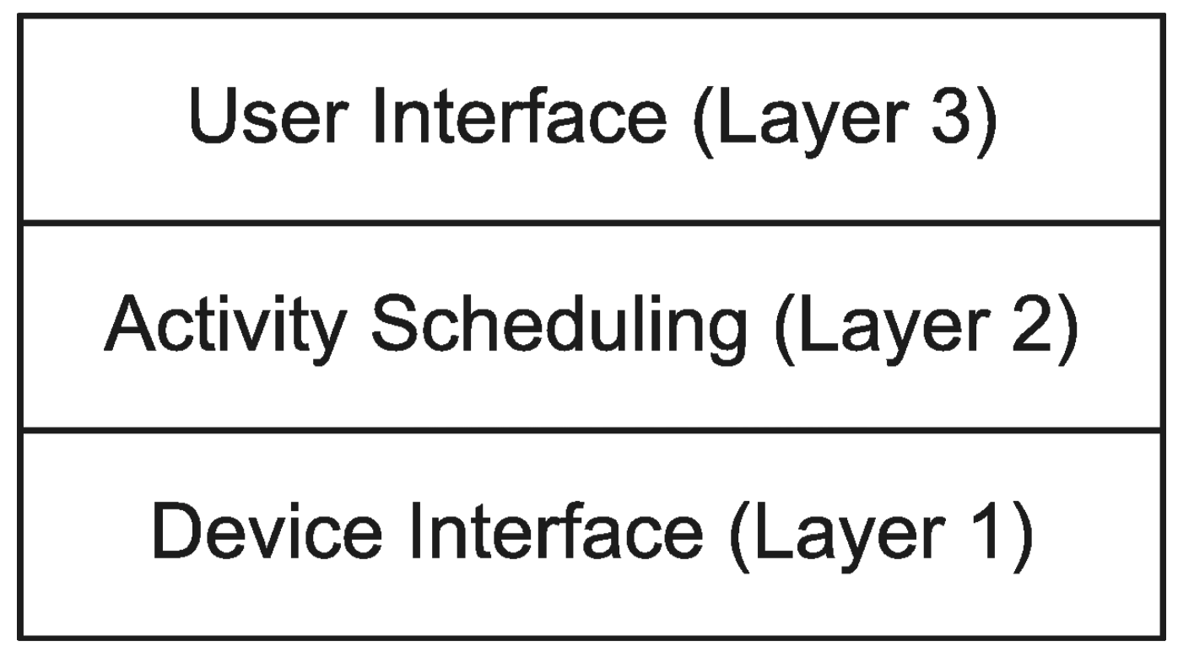
Layered Architectures
Commonalities:
Entities are grouped based on the services that they provide
Each layer hides all of the layers above and below
Visualizations:
Layer 3
Layer 2
Layer 1
Layer 0
Wedding Cake Diagram
Architecture of an HVAC Unit

Slide 7
Layered Architecture (cont.)
The Classic Three Tiers:
Presentation (Front End)
Application Logic
Storage (Back End)
Visualization:

Slide 8
Layered Architectures (cont.)
Visualization (cont.)
Layer 3
Layer 2
Layer 1
Layer 0
Onion Diagram

Slide 9
Layered Architectures (cont.)
Advantages:
Improved cohesion which allows for multiple physical deployment options (e.g., presentation and application logic on one machine; storage on another)
Decreased coupling which promotes re-use
Specialized expertise (by level)
Disadvantages:
Communicating through multiple layers can be inefficient
Often results in "cheating"

Slide 10
Client-Server Architectures

Slide 11
Client-Server Architectures
Commonalities:
Each entity has exactly one role, service provider or service consumer
Service providers wait for and then respond to requests
Service consumers initiate requests
The Alternative:
The entities are peers (i.e., all play the same roles)

Slide 12
Client-Server Example
The WWW:
Identify the client(s)
Identify the server(s)
X-Windows:
Identify the client(s)
Identify the server(s)

Slide 13
Client-Server Architectures (cont.)
Advantages:
Same as for layered architectures
Centralized control
Disadvantages:
"Single" point of failure
Difficult to scale (especially to balance loads)

Slide 14
Pipe and Filter Architecture

Slide 15
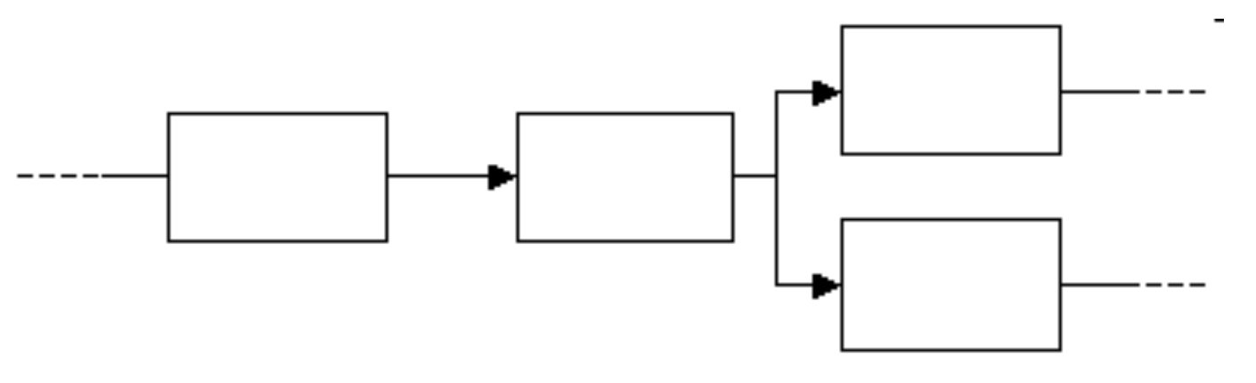
Pipe and Filter Architectures
Commonalities:
Treat inputs/outputs as streams (i.e., infinite sequences of bytes)
Group entities into filters (i.e., those that process streams) and pipes (i.e., those that connect sources and sinks)
A Visualization:

Slide 16
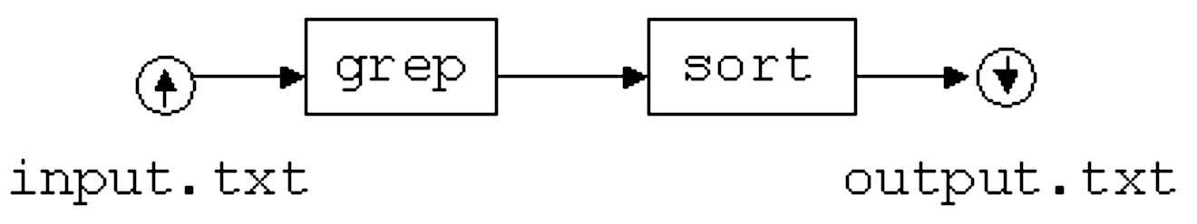
Pipe and Filter Examples
The Problem:
Read a file and print all of the lines that contain a particular string. The output should be sorted alphabetically.
The Solution (in Unix):
A Diagram:

Slide 17
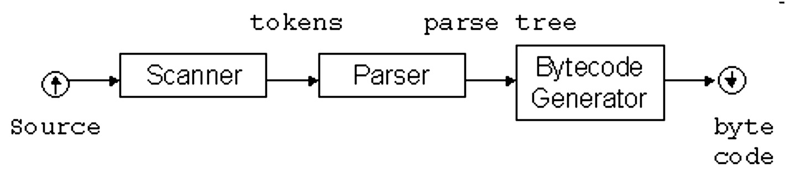
Pipe and Filter Examples (cont.)
The Problem:
Read a file that contains Java source code and produce the associated byte code.
A Diagram of the Java Compiler:

Slide 18
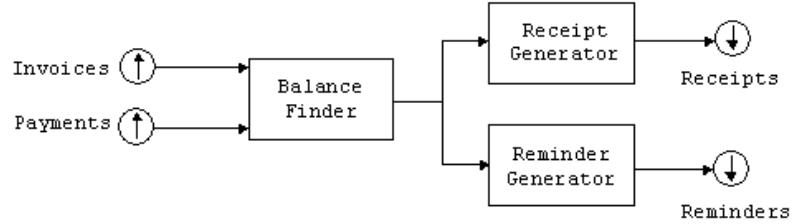
Pipe and Filter Examples (cont.)
The Problem:
Read a file that contains invoices and payments and prints receipts and reminders.
A Diagram:

Slide 19
Pipe and Filter Architectures (cont.)
Advantages:
Simple
Easy to extend and/or modify
Disadvantages:
Forces lowest-common-denominator data transmission
Queue overflows
Unidirectional data flow
Not good for interactive systems

Slide 20
Event Driven Architectures

Slide 21
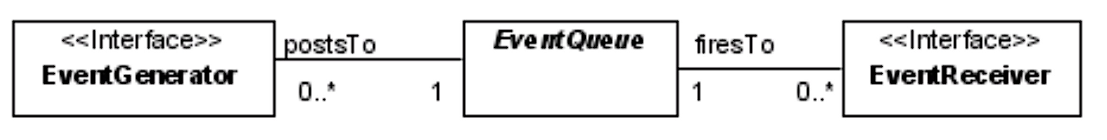
Event Driven Architectures
Commonalities:
Entities are grouped into event generators/producers and event receivers/handlers
Generators and receivers communicate through an intermediary (called an event queue)
Visualization:
Terminology:
Event generators post/announce events
The event queue invokes/fires to event handlers/receiver

Slide 22
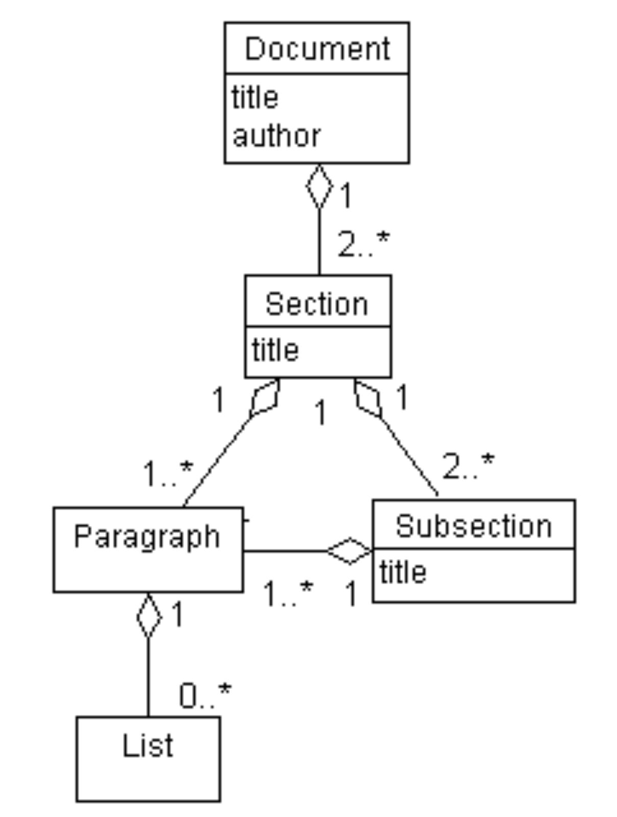
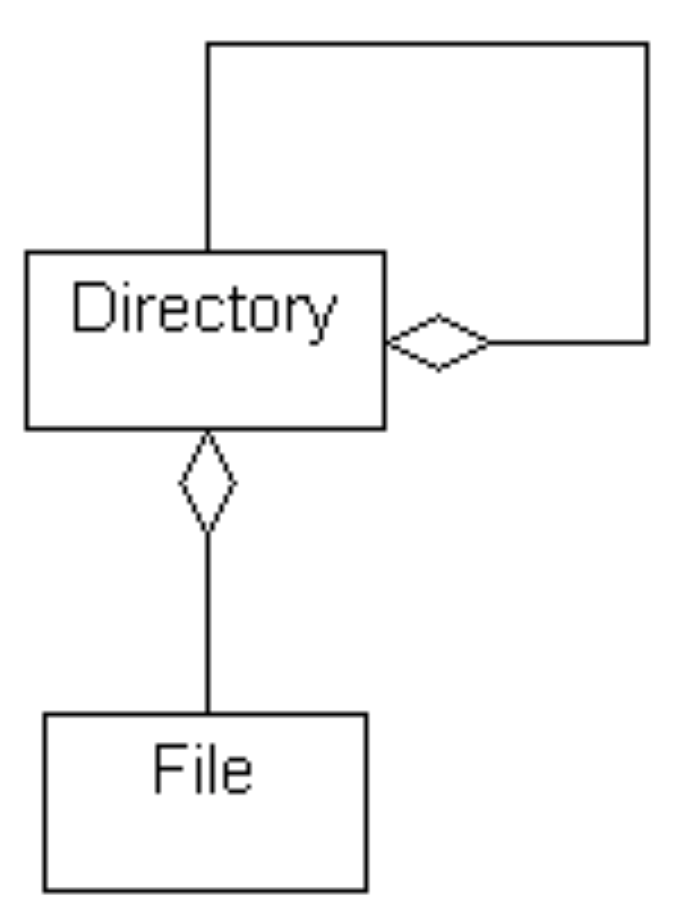
Event Driven Architectures (cont.)
Bubbling/Hierarchical:
A (usually predefined) hierarchy of objects that handle events
Listening:
The receivers/handlers (called listeners/observers) inform the queue (using a process called registration) that they want to be notified of specific events

Slide 23
Event Driven Architectures (cont.)
Advantages:
Promotes re-use
Easy to modify
Disadvantages:
Makes synchronization difficult

Slide 24
MVC

Slide 25
Model-View-Controller
Models – to realize problem-domain function
View – to display data to users
Controllers – to receive and carry out commands from users

Slide 26
Model-View-Controller (cont.)
An Example

Slide 27
Model-View-Controller (cont.)
Advantages:
Views and controllers can be added, removed, and changed without disturbing the model.
Views can be added or changed, even during execution
The components of the user interface can be changed, even at runtime.
Disadvantages:
Views and controllers are often hard to separate
Frequent updates may slow data display and degrade user interface performance.
User interface components highly depend on model components.

Slide 28
Architectural Styles in Context
Some Domains:
Instruction set architectures
Microarchitectures
Application architectures
Network architectures
Some Observations:
Many styles are used in multiple domains
Some issues arise in some domains but not others (e.g., geometry matters in chip design but not in application programming)

Slide 29
Identifying Architectural Styles
Abstract away from the architectures used in existing systems
Create an idealization (sometimes called a reference architecture)

